Slide 1
Neuro-Symbolic Program Corrector for Introductory Programming Assignments
ICSE 18
Sahil Bhatia, Pushmeet Kohli, Rishabh Singh
2020-05-14
JuHyoung Kim
kjhkjh75@naver.com

Slide 2
Introduction
Use the set of student submissions without syntax errors to learn a model of token sequences
Use RNN to learn the token sequence model that can learn large contexture dependencies.
Use constraint-based program
Use SKETCH solver to find minimal changes becomes functionally equivalent to a reference implementation

Slide 3
Introduction
Novelty
Use a language model learnt from syntactically correct programs to fix syntax errors
Learn a RNN that can more complex dependencies than n-gram or logbilinear neural network
Generate more precise repairs for different problems.

Slide 4
Introduction
Consider two types of parsing errors in python programs
1. syntax errors
2. indentation errors
Use python compiler to locate the potential error locations
Algorithm enumerates subsequences of predicted sequence in a ranked order to generate proposals.
Compiler is not able to accurately locate the exact location for syntax errors.
-> algorithm ignores present tokens considers the prefix previous line.
Neural network perform the prediction of next k tokens after prefix sequence.
Notes:
알고리즘은 오류 위치에서 삽입 또는 교체를 위한 제안서를 생성하기 위해 순위에 따라 예측 시퀀스의 반복을 열거한다.

Slide 5
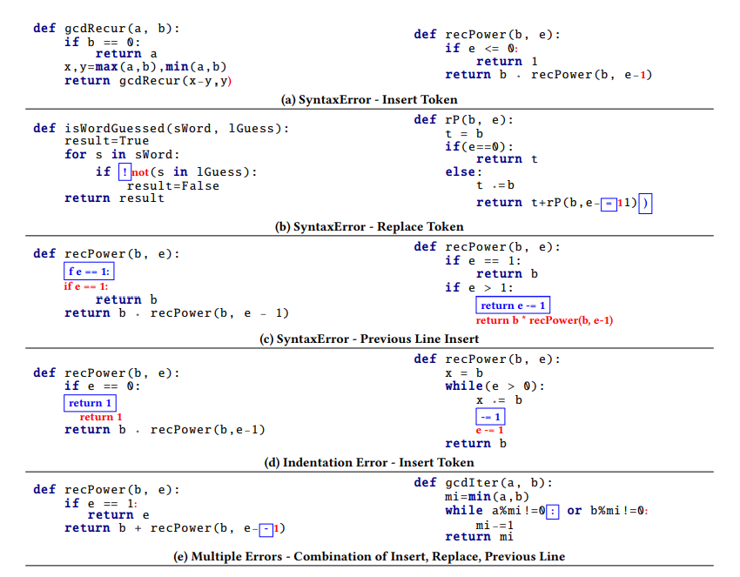
Process
Notes:
a 같은 경우는 괄호나 부분으로 표시된걸 삽입해서 완성시키는 문법오류
(b)같은 경우는 잘못된부분 대체 하는부분
c같은경우는 잘못 입력된 스펠링이나 잘못표현된 부분을 전체 대체한다.
컴파일러는 항상 에러위치를 정확하게 말해주지 못하기 때문에
에러가 나오는 이전 라인을 모델에 넣어서 새라인으로 끝나는 토큰 시퀀스를 예측

Slide 6
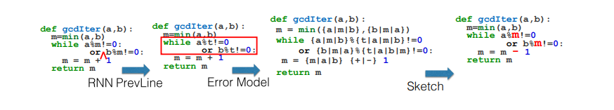
Process
The fixes may or may not correspond to the correct semantic fix
Use SKETCH solver to compute minimal modification becomes equivalent teacher`s implementation.
Notes:
이 모델 같은경우는 컴파일러로 에러위치가 파악이 되지 않아 rnn모델 사용해서 전체라인 예측한 것인데 SKETCH solver 를 통해

Slide 7
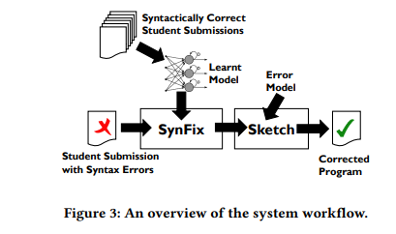
Process
Use the set of all syntactically correct submissions to learn a generative token sequence.
Use SynFix algorithm to find small syntactic corrections
Use the SKETCH synthesis to find minimal modification.

Slide 8
Process
Use RNN to check syntactically correct
Use a threshold frequency value to decide whether to relabel to a general IDENT token for handling rarely used tokens
A token is encoded into a fixed-length one-hot vector.

Slide 9
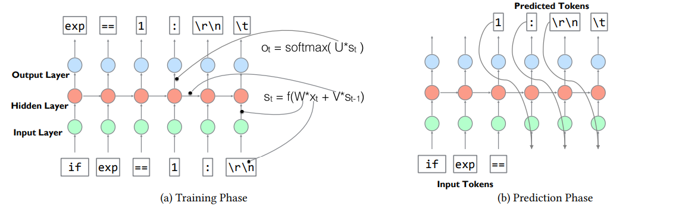
Process

Slide 10
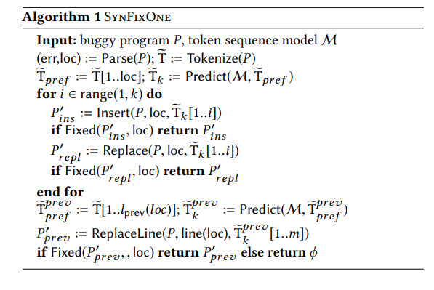
Process
return P ′ (if possible)
ϕ = syntax can not be fixed
Uses a parser to obtain type of error and token location
Loc = error token location
Tpref = prefix of token sequence
a[i..j] = subsequence of sequence of a
Notes:
예측 시퀀스인 Tk를 얻고나서 알고리즘은 토큰 시퀀스를 증가하면서 검색한다. 삽입하던 대체하든 문법 오류가 안나타날때까지 알고리즘이 문법오류가 안나는 시퀀스를 못찾는다면 다른 Tpref 를 찾는다 이 후보군은 에러 토큰 위치가 있는 라인의 모든 이전 토큰을 무시한다.
최종적으로 알고리즘은 예측된 토큰과함께 에위치를 포함하는 줄을 대체하는지 체크한다.

Slide 11
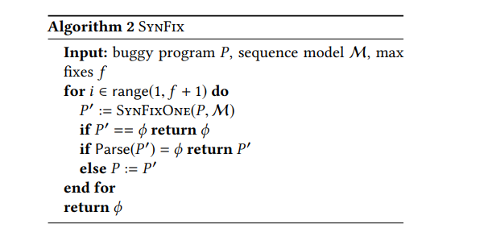
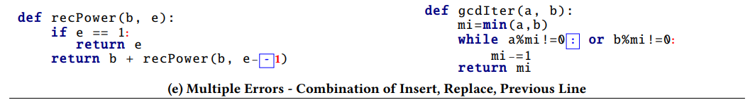
Multiple syntax errors

Slide 12
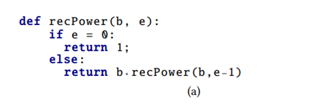
Process
Tk = [’==’, ’0’, ’:’]
e == = 0: Insert case
-> not fixed
e == 0: replace case.
Notes:
처음 = 에러 위치가 포착되면 e 까지 이전 시퀀스로 받고나서정해진 길이만큼 predict 한다
K= 3 이라면 == 0 : 까지 예측 하게되는데 먼저 삽입을 진행하게되는데 e== =0:가되어 오류가 남 그다음 대체를 진행하게 되어 성공하게됨

Slide 13
Process
Comparison operators: cop → {< | ≤ | > | ≥ |! = | ==}
Arithmetic operators: aop → {+|− | ∗ |/|%}
Variable replacement: v →?v on RHS of assignments and expressions
off-by-one errors: a → {a+1, a−1, 0, 1}
Constant modification: n → ??, where ?? denotes any integer constant value

Slide 14
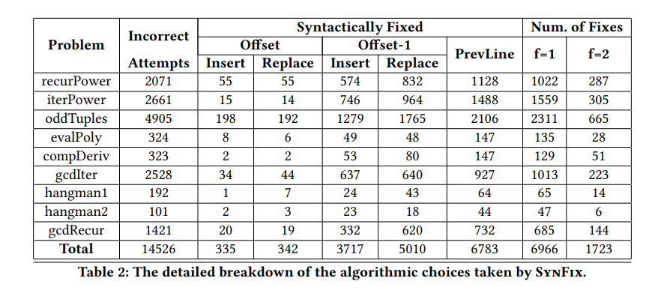
Result
Offset: the prefix token sequence is constructed from the start of the program to the error token
Offset-1: the prefix token sequence is constructed upto one token before the error token
PrevLine: the prefix token sequence is constructed upto the previous line and the error line is replaced by the predicted token sequence

Slide 15
Result
def rP(b, e):
t = b
if(e==0):
return t
else:
t ∗ = b
return t+rP(b,e − = 11) )
Offset : upto =
Offset : upto –
PrevLine : replace return statement

Slide 16
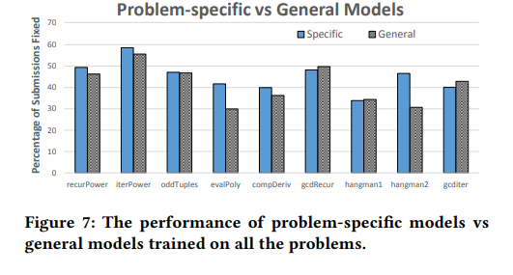
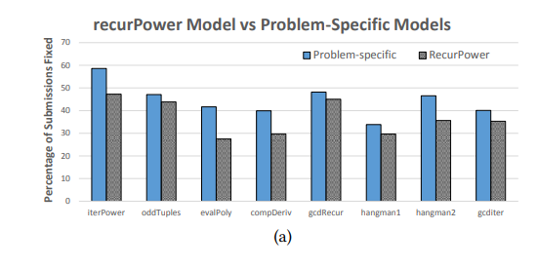
Result
One syntactic error.

Slide 17
Idea
def getSumValue(a,b)
if a == 1:
return num2
else :
return a + b
Def func((var_1,var_2):
if var_1 == num1:
return num2
else :
return var_1+var_2

Slide 18
Idea
Search all training set and find frequent Name
Ex) is, set, get, rec, sum, Iter etc. (Camel)
Categorizing the function with frequent word
Make model each
Choose train model with word similarity.
+ similarity score.

